Slide 1
First-principles calculations of opto-electronic and thermoelectric properties double perovskite semiconductors M₂ScInCl₆ (M = Rb, Cs)
Mohammad Abdur Rashid
Md. Borhanul Asfia, Sahadat Jaman

Slide 2
Outline
Lead-free double perovskite
Our systems of study: Rb₂ScInCl₆ and Cs₂ScInCl₆
Computational details
Opto-electronic properties
Thermoelectric properties
Conclusions

Slide 3
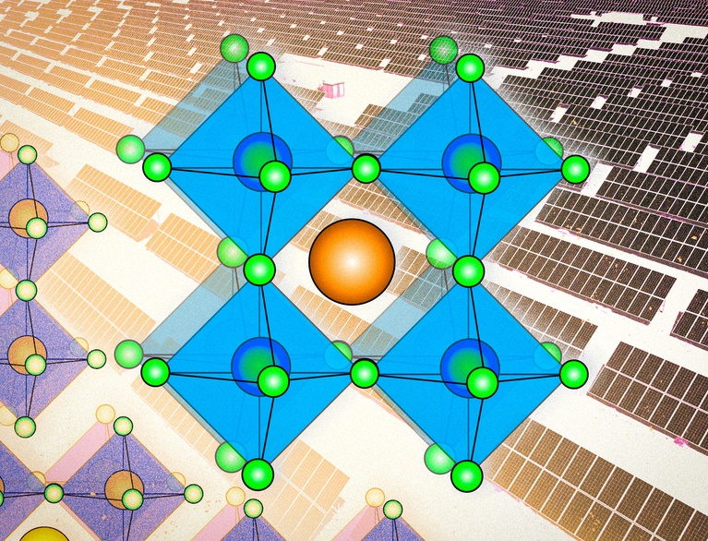
Perovskite solar cells
High power conversion efficiency (about 25%)
Easier manufacturing process
Lower cost and greater flexibility
Perovskites degrade much faster
Pb-based perovskites show better
potential but they are toxic
https://news.mit.edu/2022/perovskites-solar-cells-explained-0715

Slide 4
Environmental sources of lead exposure
https://www.cdc.gov/nceh/lead/publications/refugeetoolkit/powerpoint_files/medicalservice.ppt

Slide 5
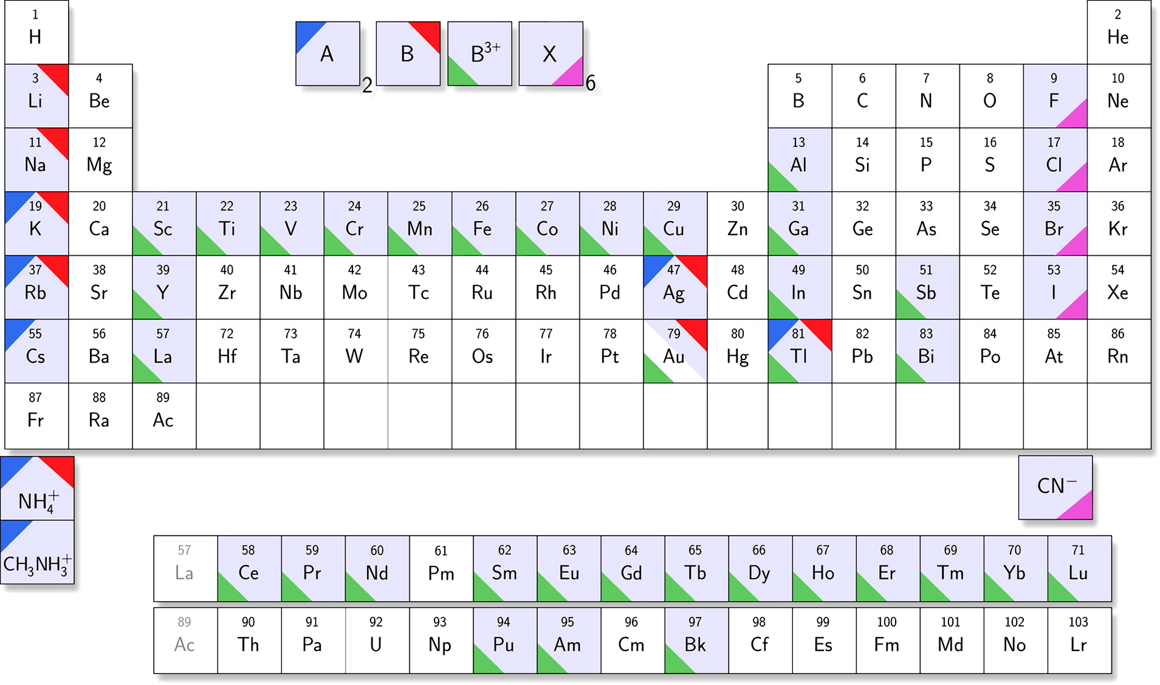
Lead-free double perovskites: A₂B⁺B³⁺X₆
https://pubs.acs.org/doi/10.1021/acsenergylett.6b00499

Slide 6
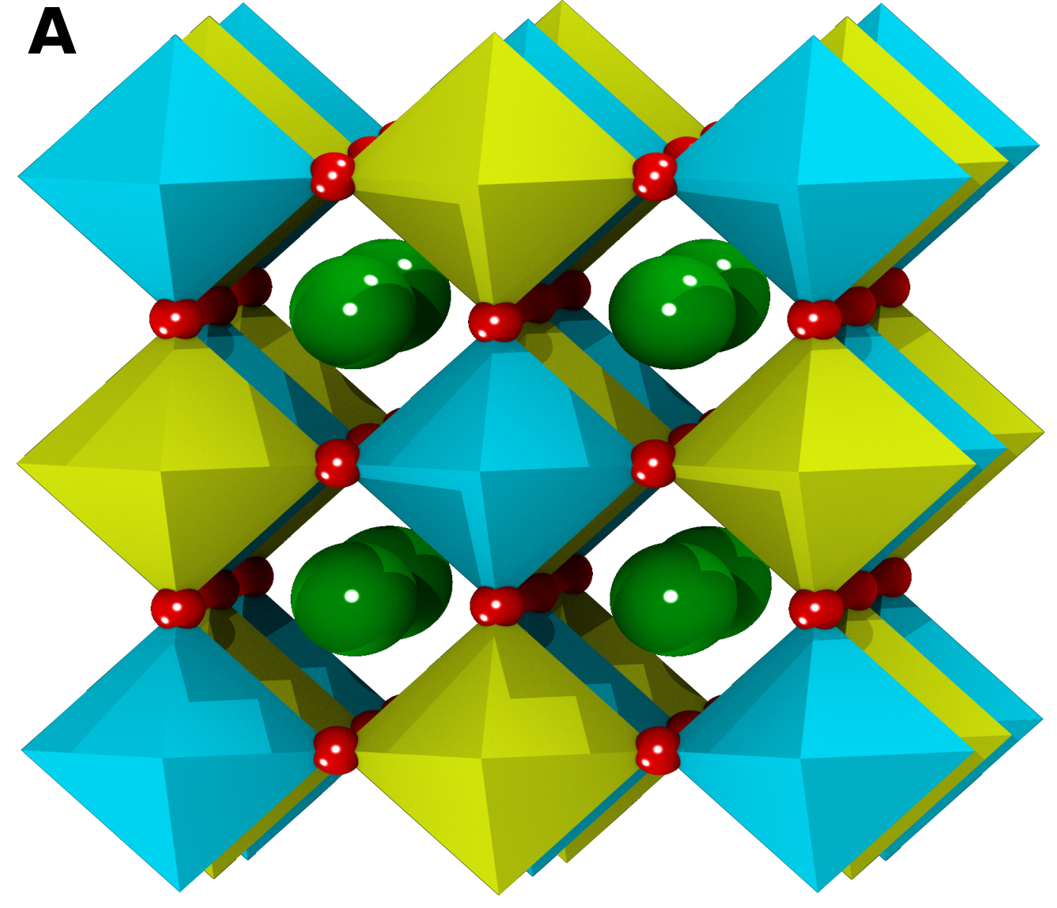
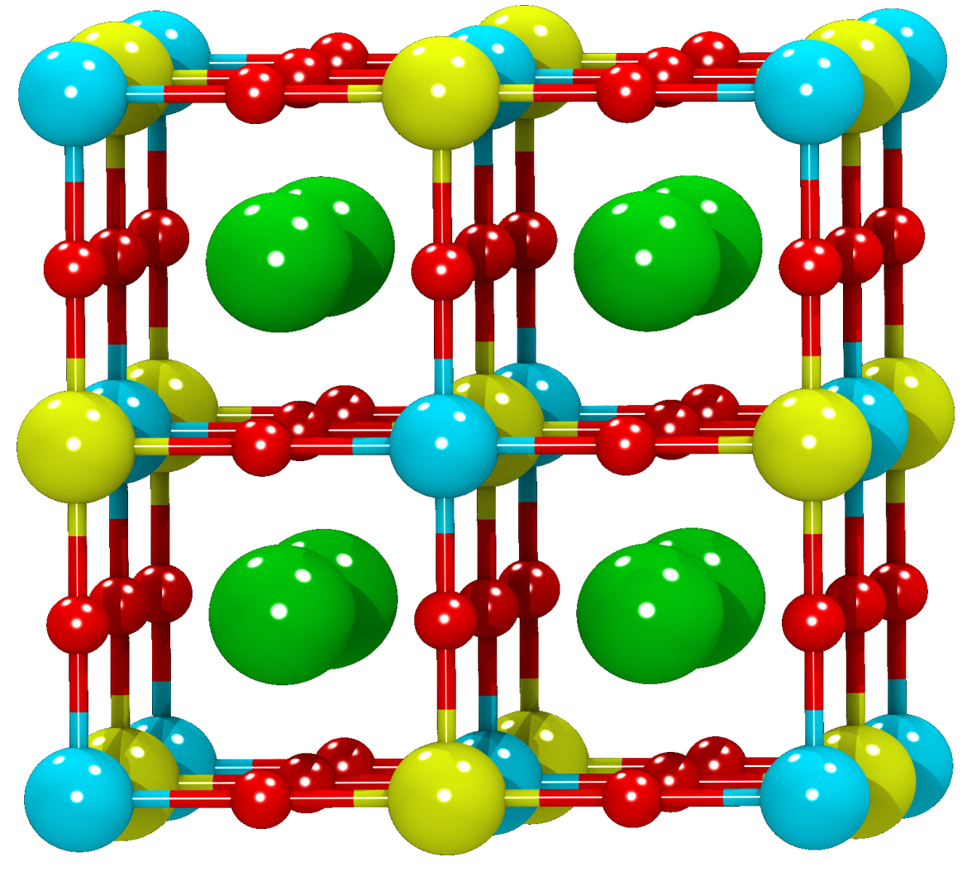
Structure of M₂ScInCl₆ (M = Rb, Cs)
Sc
In
Cl
M

Slide 7
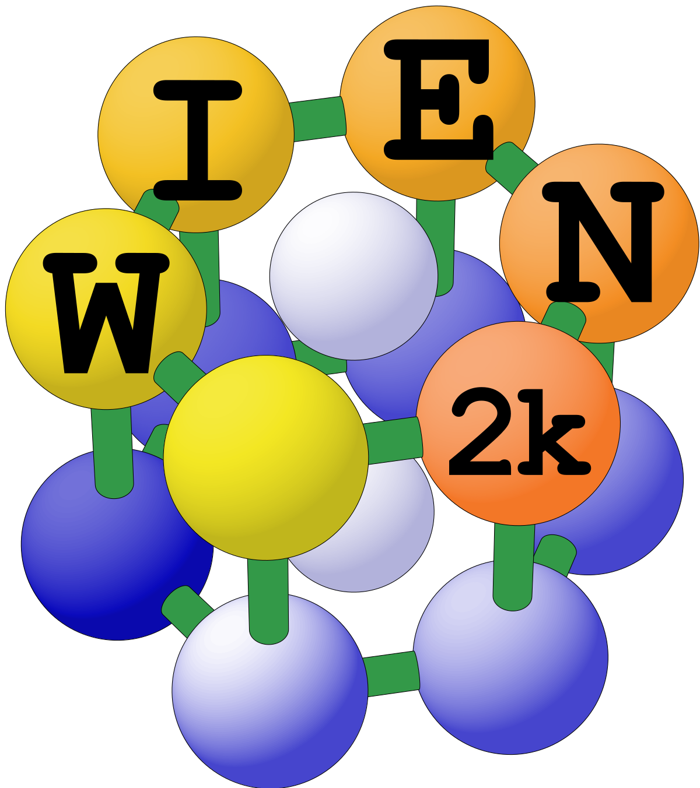
Computational details
R_{MT}(Cs, In) = 2.50 a.u.
R_{MT} (Rb, Sc) = 2.35 a.u.
R_{MT} (Cl) = 1.15 a.u.
R_{MT}×K_{max} = 8.0
K-mesh = 10×10×10
EC = 0.00001 Ry & CC = 0.0001 e

Slide 8
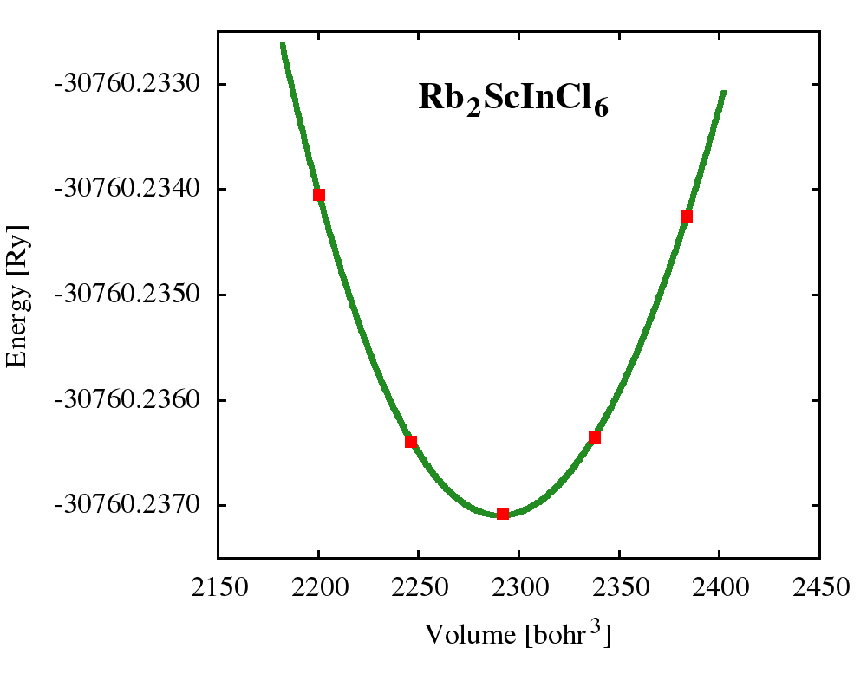
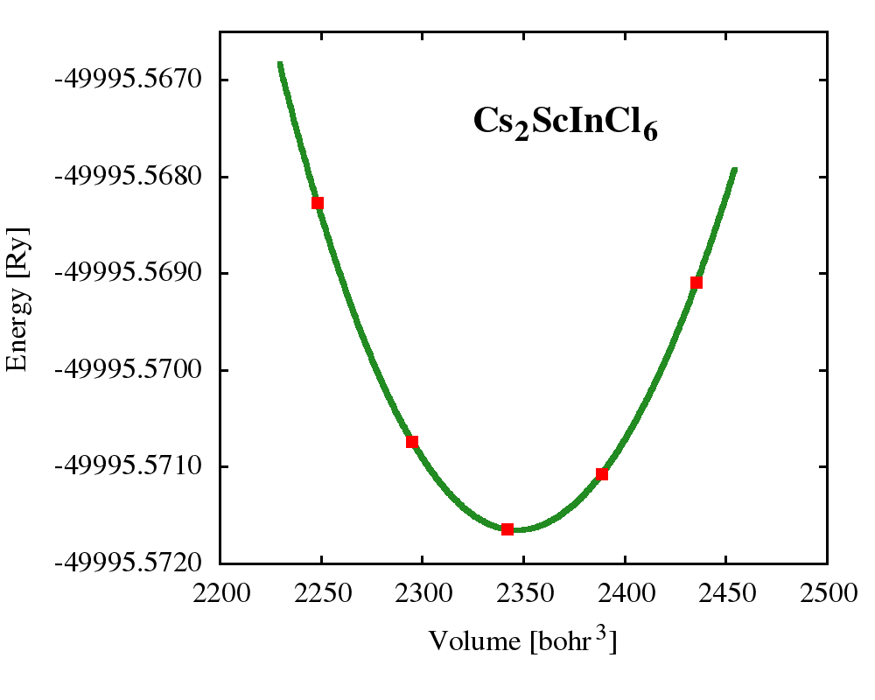
Optimized Lattice parameters

Slide 9
Optimized Lattice parameters
System | Lattice parameter (Å) | Band gap (eV)
 |  | PBE-GGA | TB-mBJ
Rb₂ScInCl₆ | 11.073 | 2.599 | 2.662
Cs₂ScInCl₆ | 11.163 | 2.802 | 2.902

Slide 10
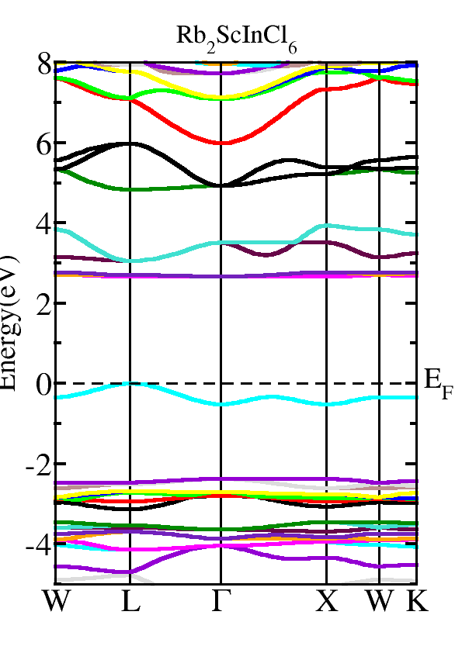
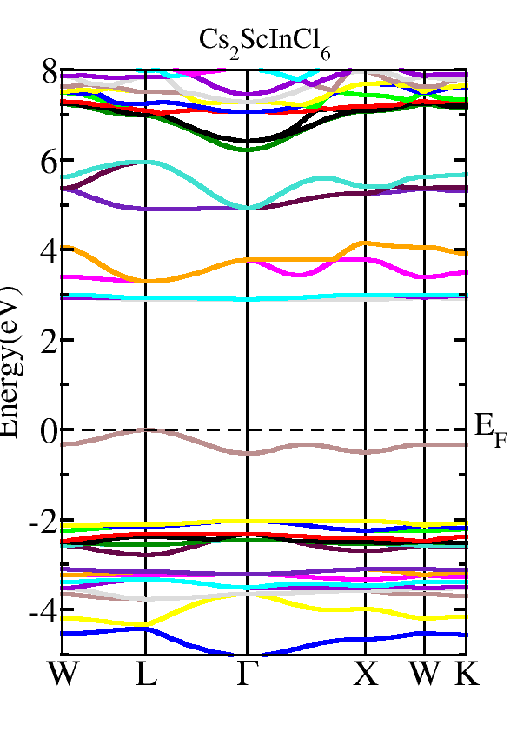

Electronic properties

Slide 11
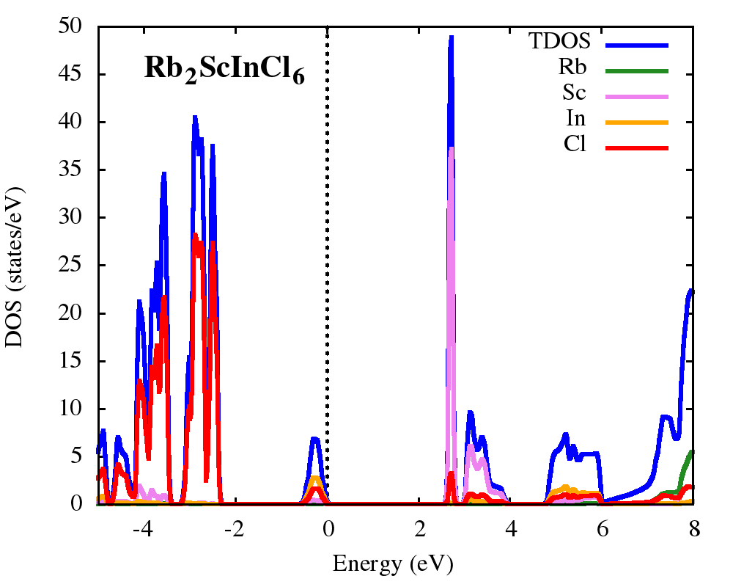
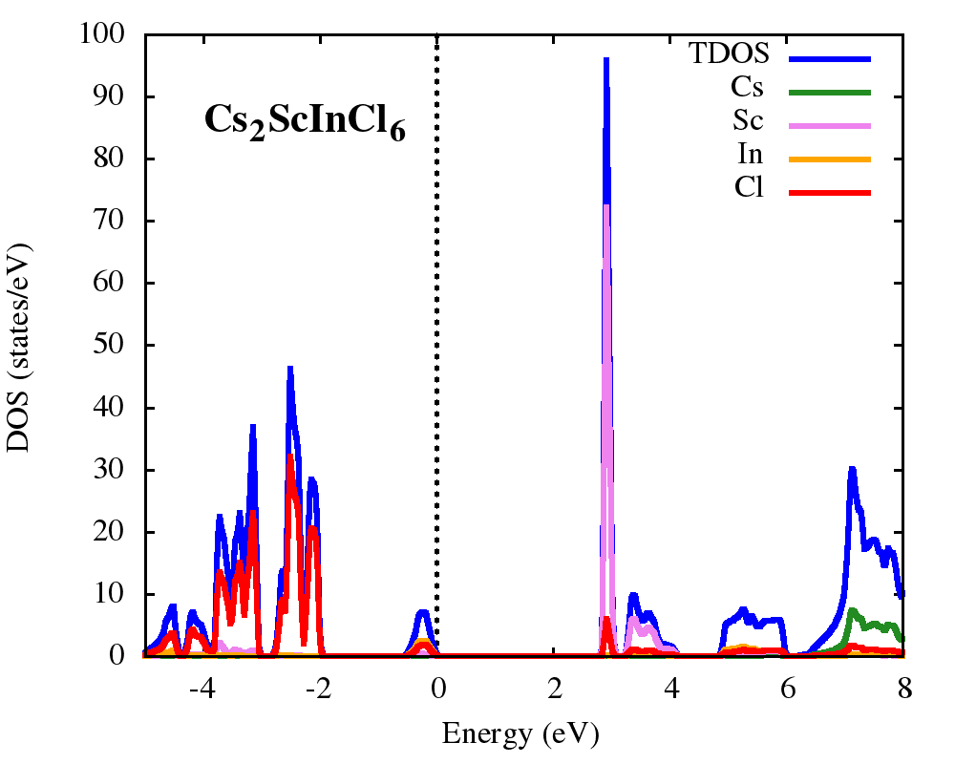
Electronic properties

Slide 12
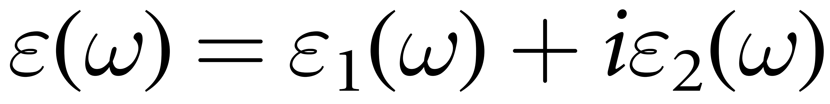
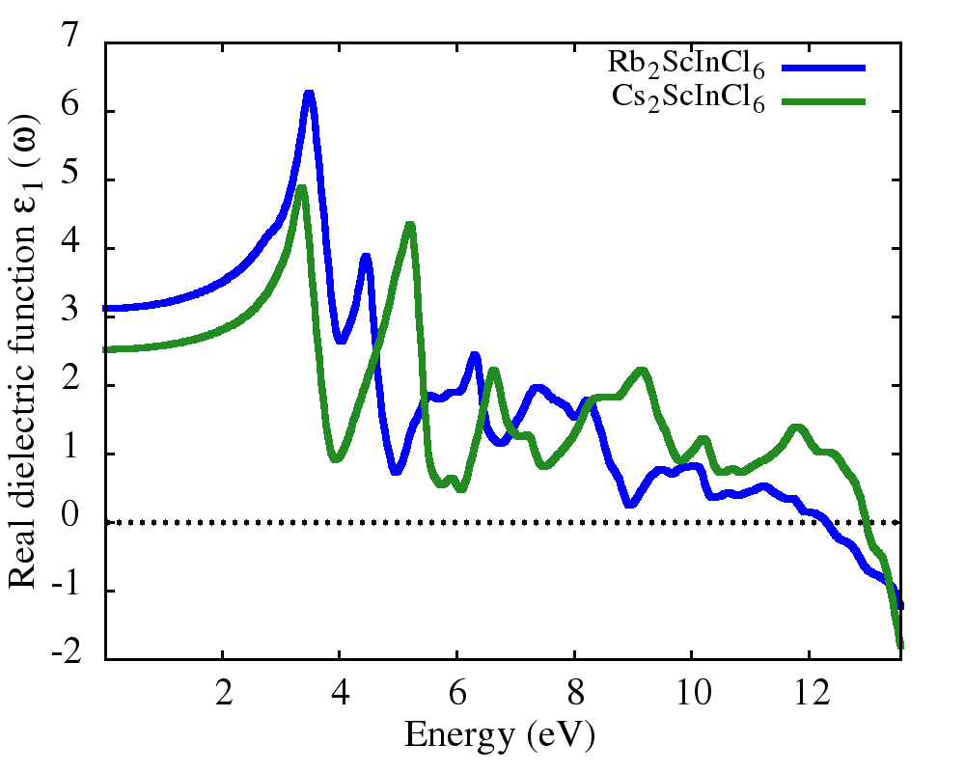
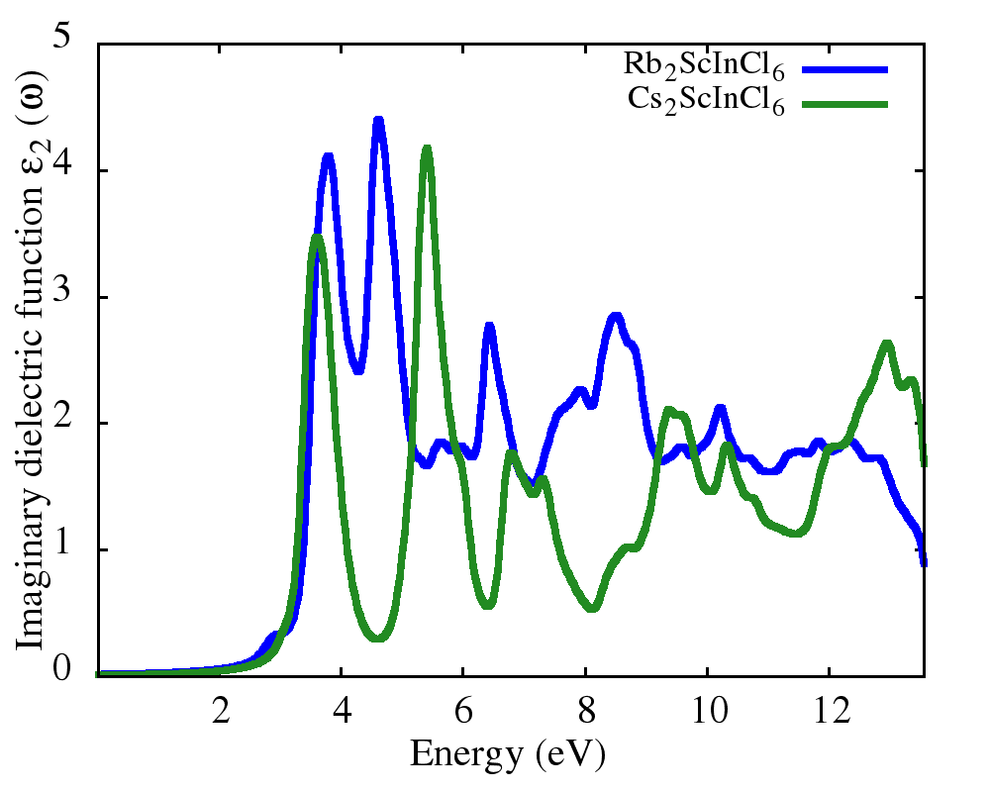
Optical properties

Slide 13
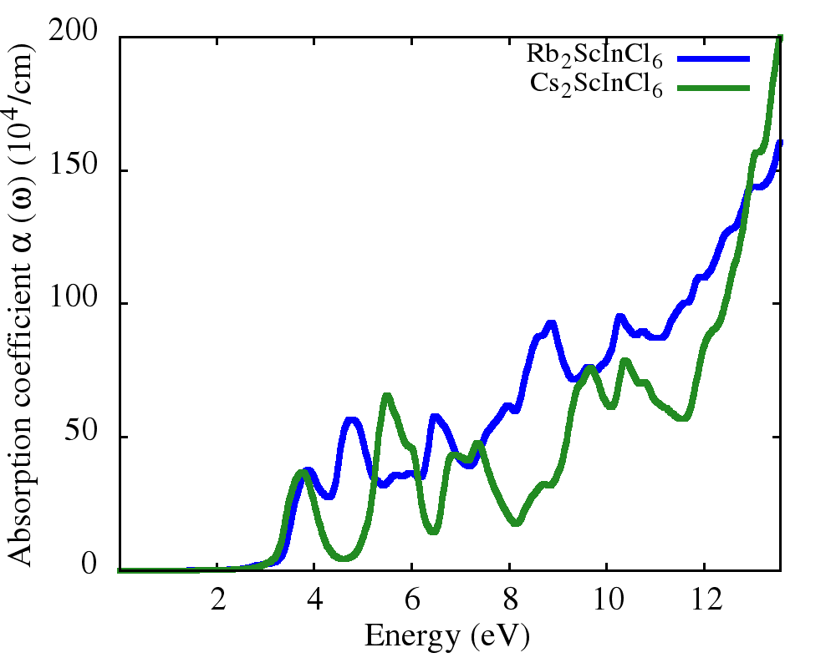
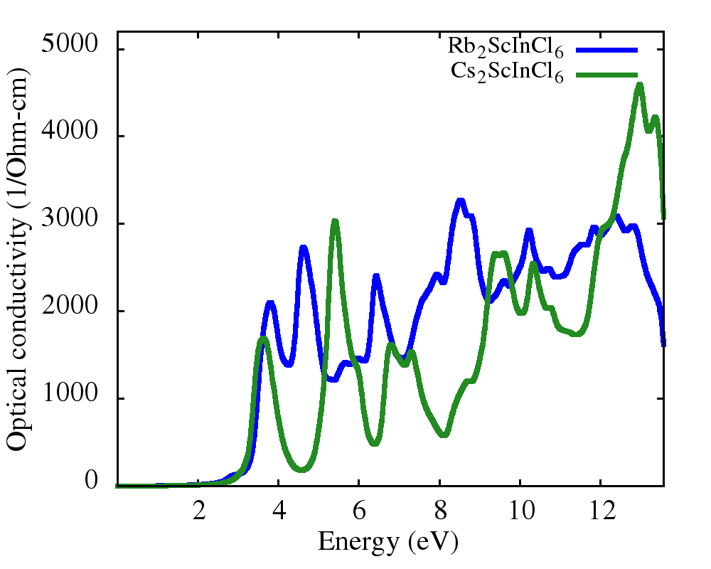
Optical properties

Slide 14
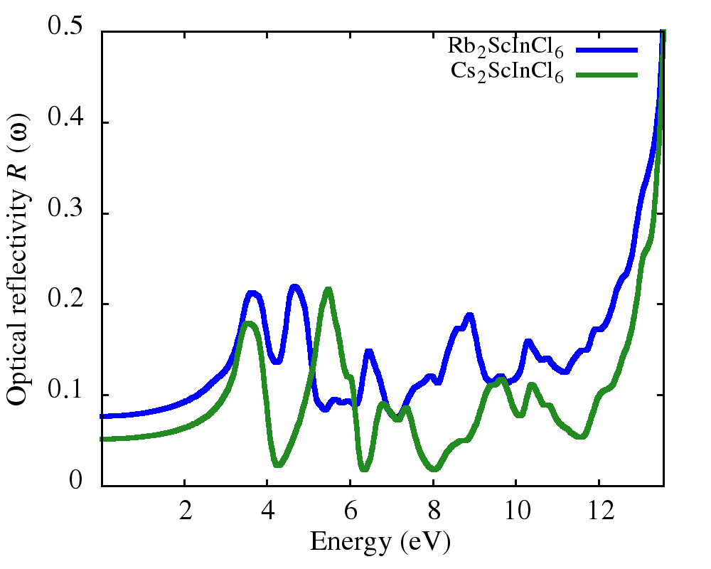
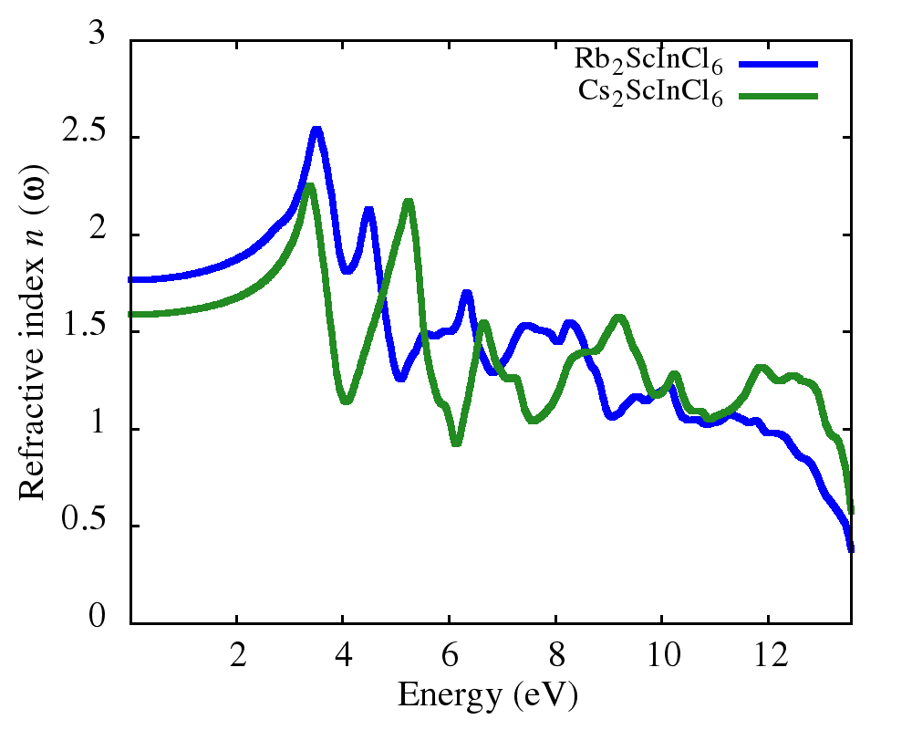
Optical properties

Slide 15
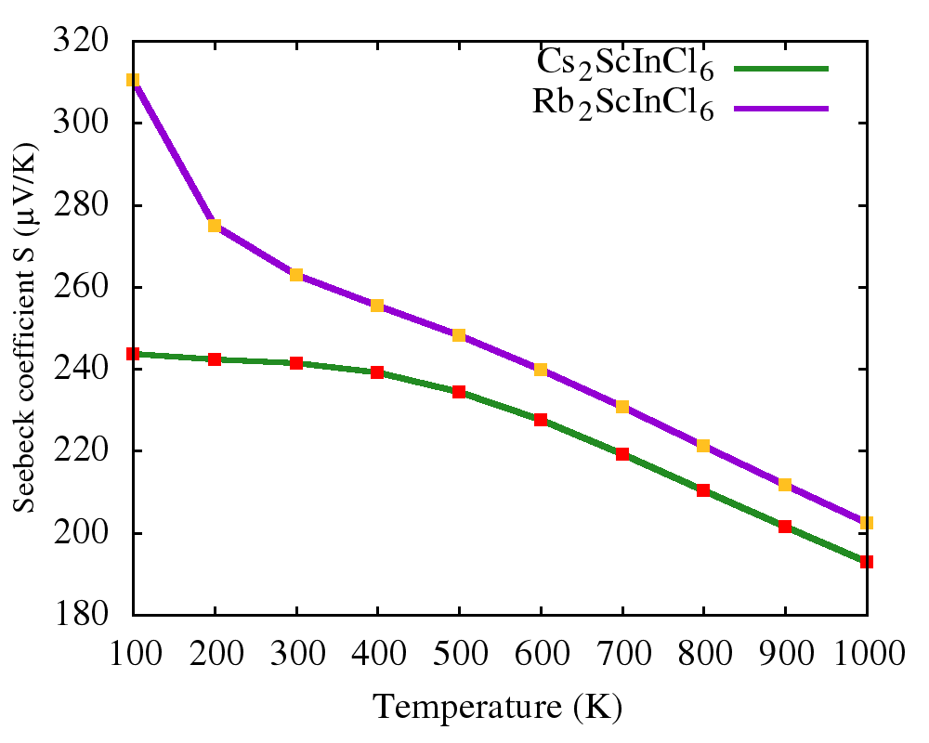
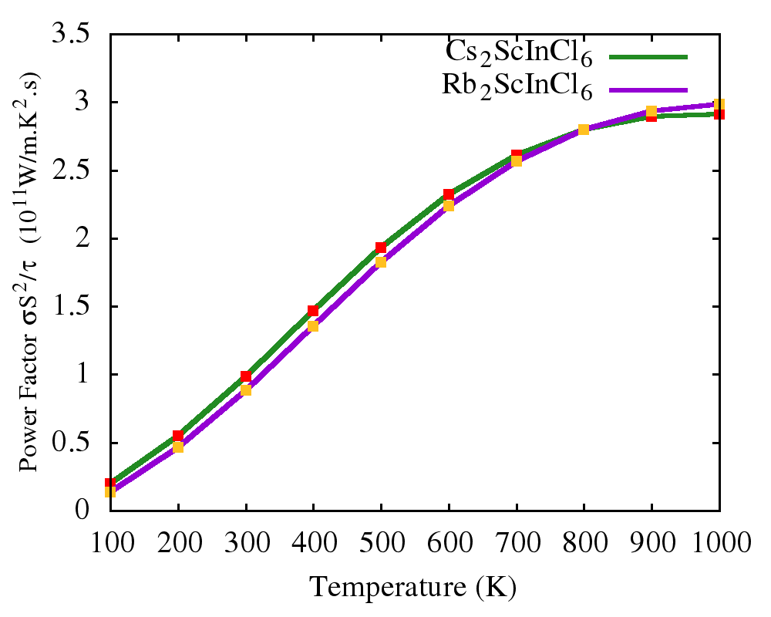
Thermoelectric properties

Slide 16
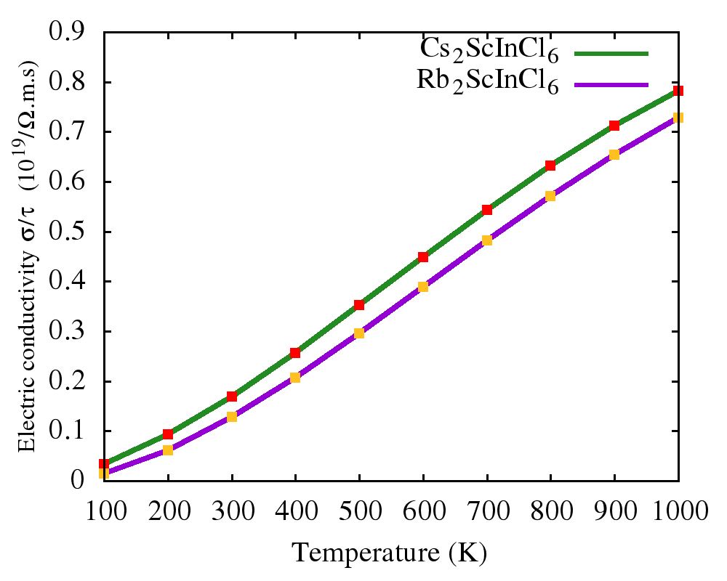
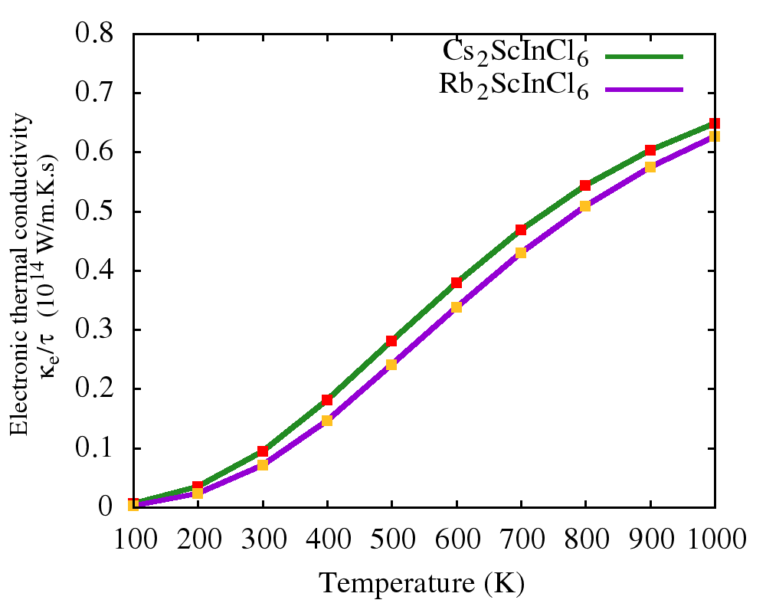
Thermoelectric properties

Slide 17
Conclusions
Opto-electronic and thermoelectric properties double perovskites M₂ScInCl₆ (M=Rb, Cs) using WIEN2k
Both compounds show semiconductor like behavior
Remarkable optical properties
Good Seebeck coefficient and power factor
Promising materials for different opto-electronic and thermoelectric applications

Slide 18


